Slide 1
A Linear Model in Matrix Form

Slide 2
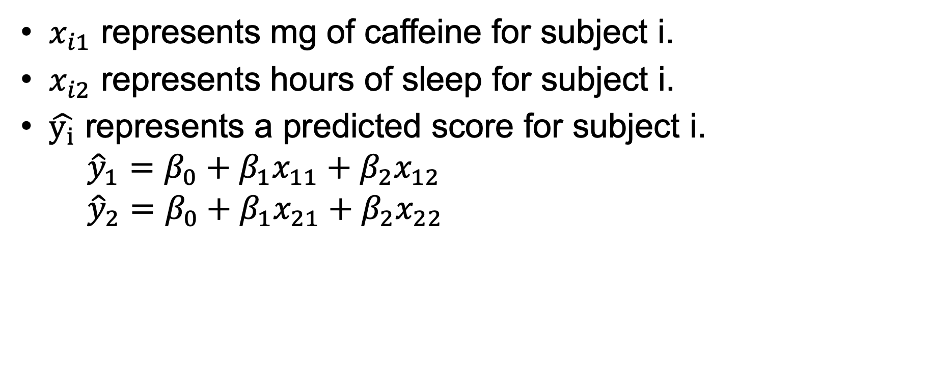
A Linear Model
$x_{i1}$ represents mg of caffeine for subject i.
$x_{i2}$ represents hours of sleep for subject i.
$\hat{y_{i}}$ represents a predicted score for subject i.
$${\hat{y}}_{1}=β_{0}+β_{1}x_{11}+β_{2}x_{12}$$
$${\hat{y}}_{2}=β_{0}+β_{1}x_{21}+β_{2}x_{22}$$
Notes:
X is called a design matrix.

Slide 3
A Linear Model in Matrix Form

